Slide 1
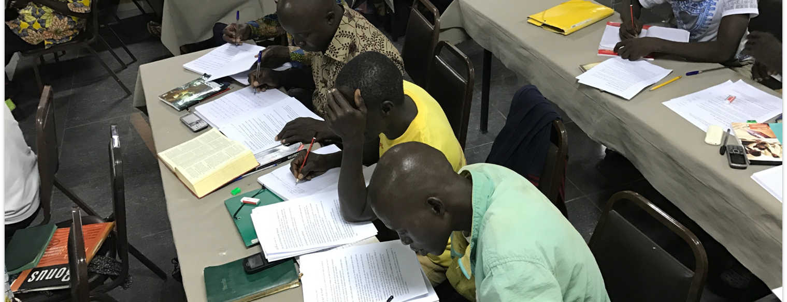
Church Owned Bible Translation
For I have not shunned to declare to you the whole counsel of God. Therefore take heed to yourselves and to all the flock, among which the Holy Spirit has made you overseers, to shepherd the church of God which He purchased with His own blood (Acts 20:27-28).
All Scripture is taken from the New King James Version®. © 1982 by Thomas Nelson, Inc. Used by permission. All rights reserved.
Four Beliefs

Slide 2
?
What is
“Church-Owned” Bible Translation?

Slide 3
Romans 12:4-6a
For as we have many members in one body, but all the members do not have the same function, ⁵ so we, being many, are one body in Christ, and individually members of one another. ⁶ Having then gifts differing according to the grace that is given to us,...
2 Timothy 2:7
⁷ Consider what I say, and may the Lord give you understanding in all things.

Slide 4
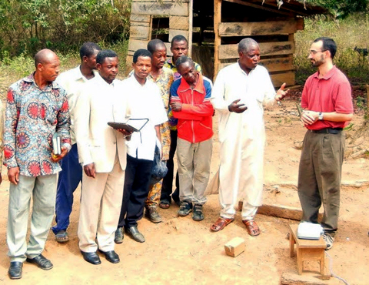
Ability
Local believers:
Know the language and culture
Have shared meaning through oral translation
Have unique, God-given abilities

Slide 5
Matthew 28:18-20
And Jesus came and spoke to them, saying, “All authority has been given to Me in heaven and on earth. ¹⁹ Go therefore and make disciples of all the nations, baptizing them in the name of the Father and of the Son and of the Holy Spirit, ²⁰ teaching them to observe all things that I have commanded you; and lo, I am with you always, even to the end of the age.” Amen.
Acts 1:8
But you shall receive power when the Holy Spirit has come upon you; and you shall be witnesses to Me in Jerusalem, and in all Judea and Samaria, and to the end of the earth.”

Slide 6
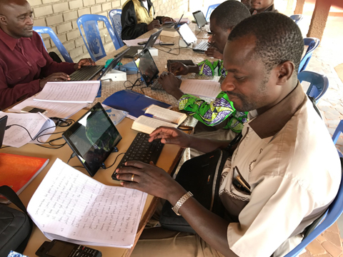
Ability
Authority
God’s Spirit gives the local church:
Wisdom
Authority

Slide 7
1 Peter 3:15
But sanctify the Lord God in your hearts, and always be ready to give a defense to everyone who asks you a reason for the hope that is in you, with meekness and fear;
Colossians 3:16
Let the word of Christ dwell in you richly in all wisdom, teaching and admonishing one another in psalms and hymns and spiritual songs, singing with grace in your hearts to the Lord.
2 Timothy 2:2
And the things that you have heard from me among many witnesses, commit these to faithful men who will be able to teach others also.

Slide 8
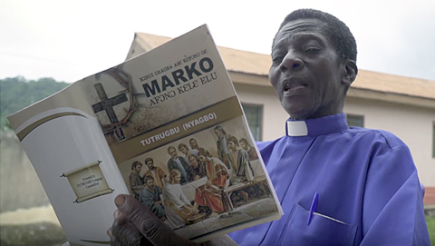
Ability
Authority
Responsibility
The local church is responsible for:
Evangelism
Discipleship
Bible Translation

Slide 9
Romans 14:12
So then each of us shall give account of himself to God
1 Corinthians 2:12-13
Now we have received, not the spirit of the world, but the Spirit who is from God, that we might know the things that have been freely given to us by God.
13 These things we also speak, not in words which man’s wisdom teaches but which the Holy Spirit teaches, comparing spiritual things with spiritual.

Slide 10
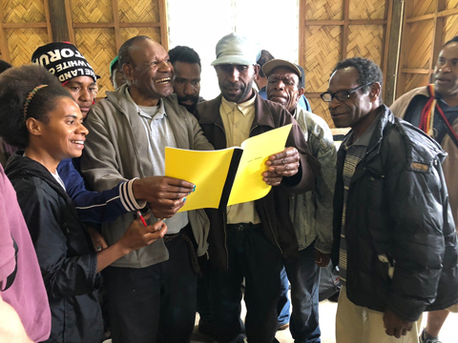
Ability
Authority
Responsibility
Translators are accountable to:
God
Their community
Accountability

